Slide 1
ALGORITHMS Counting Sort
Asma Fariha
Lecturer, Department of Computer Science
American International University-Bangladesh (AIUB)
asma.fariha@aiub.edu

Slide 2
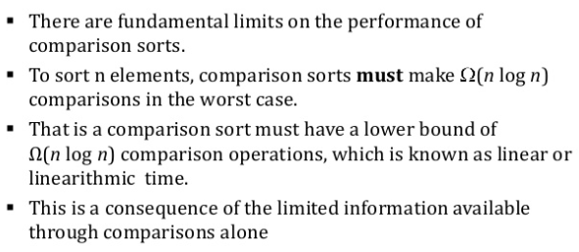
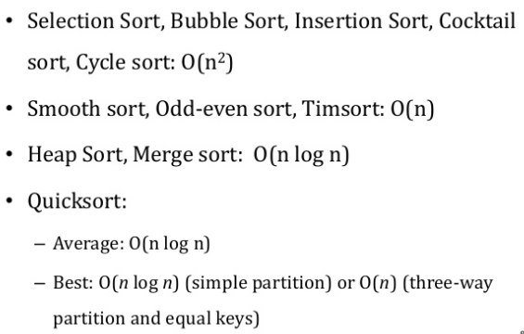
Limitations of Comparison Sort

Slide 3
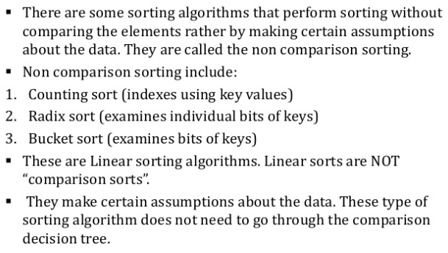
Non-Comparison Sort

Slide 4
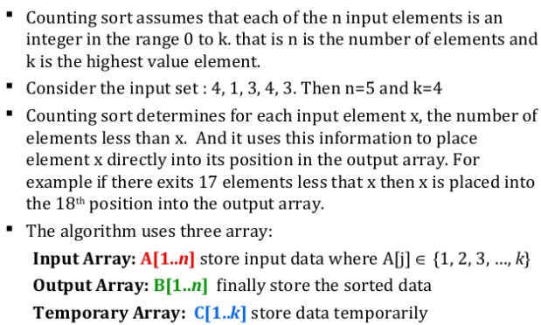
Counting Sort

Slide 5
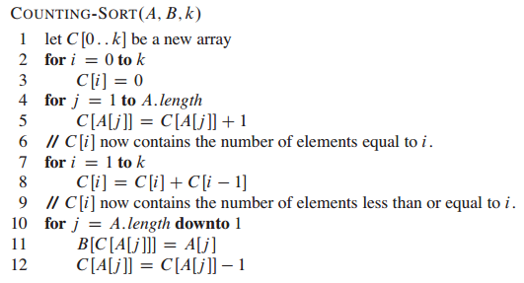
Counting Sort Pseudo-code

Slide 6
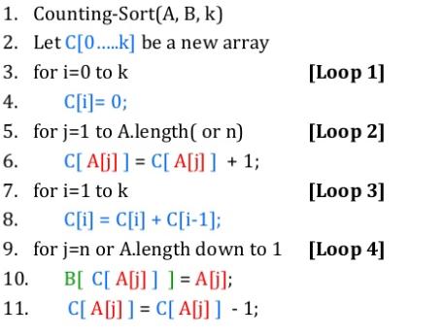
Counting Sort Pseudo-code (Cont.)

Slide 7
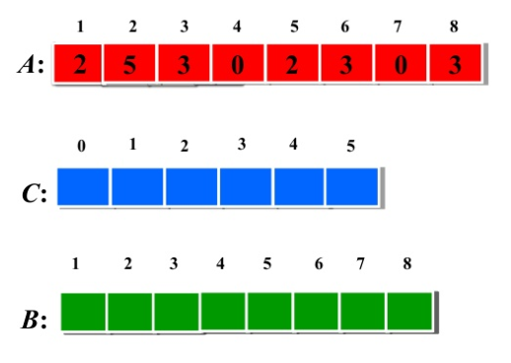
Counting Sort Example

Slide 8
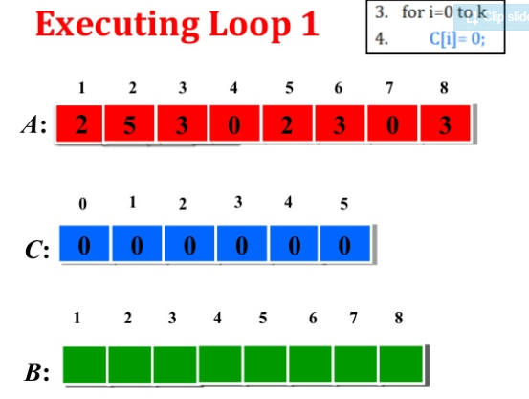
Counting Sort Example

Slide 9
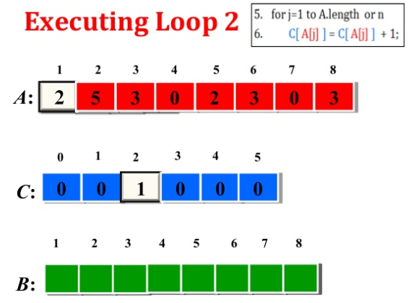
Counting Sort Example

Slide 10
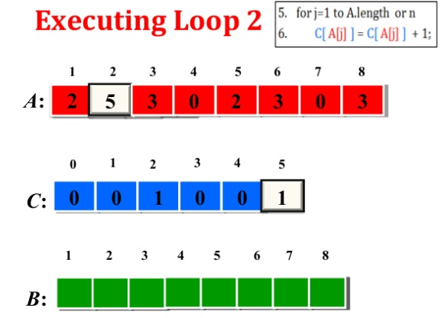
Counting Sort Example

Slide 11
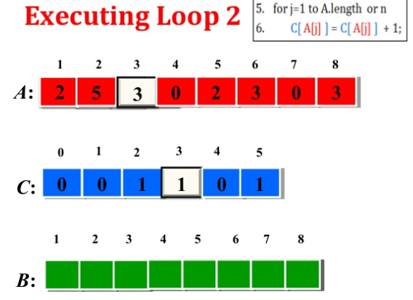
Counting Sort Example

Slide 12
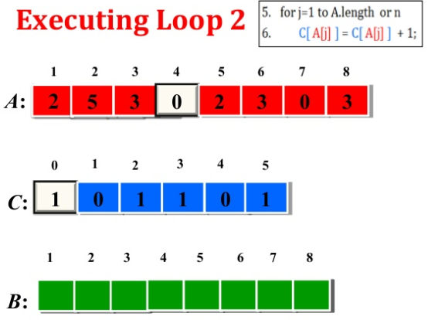
Counting Sort Example

Slide 13
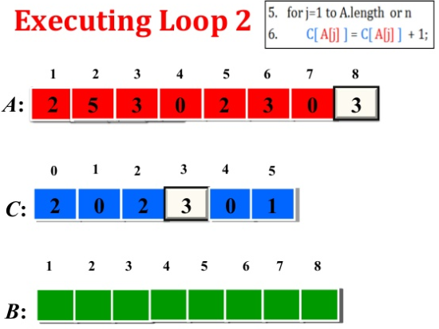
Counting Sort Example
In this way after executing loop 2 till Array input 8 we get:

Slide 14
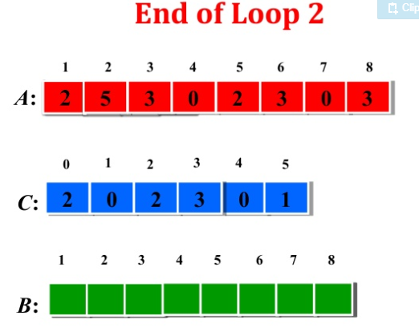
Counting Sort Example

Slide 15
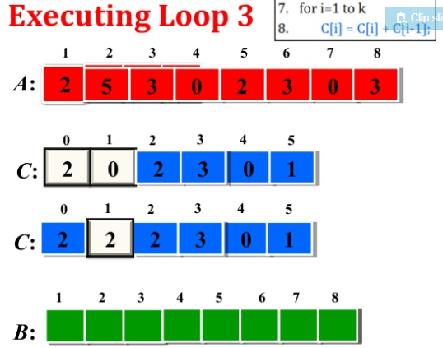
Counting Sort Example

Slide 16
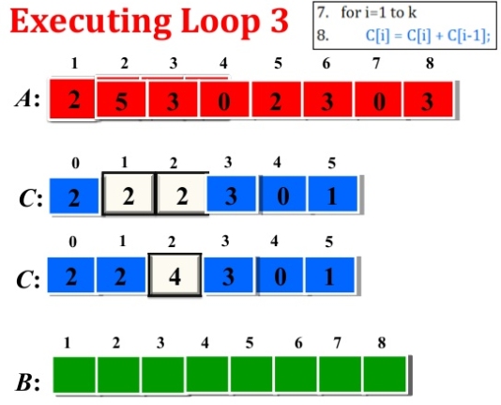
Counting Sort Example

Slide 17
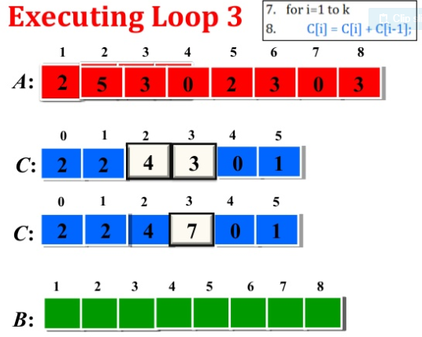
Counting Sort Example

Slide 18
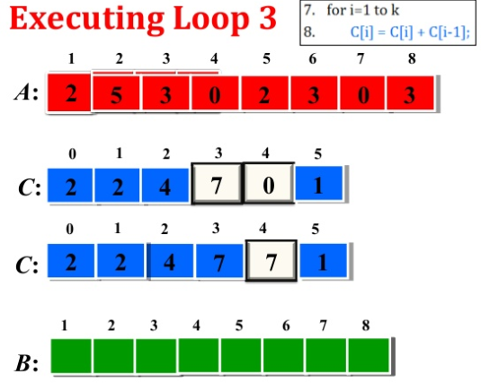
Counting Sort Example

Slide 19
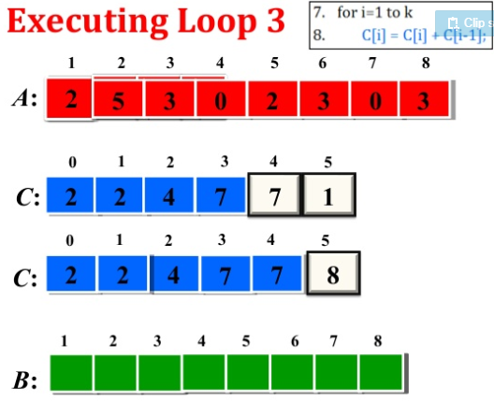
Counting Sort Example

Slide 20
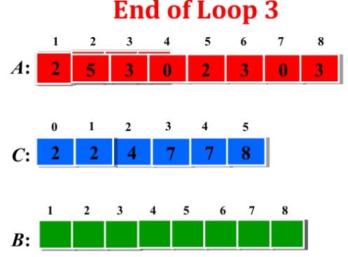
Counting Sort Example

Slide 21
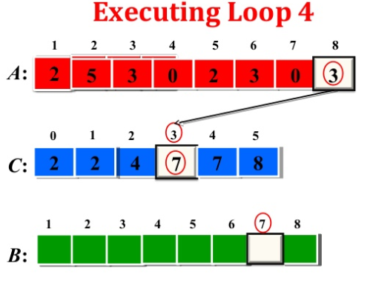
Counting Sort Example

Slide 22
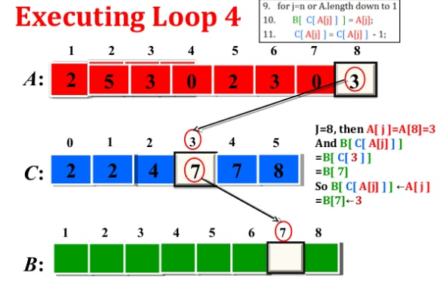
Counting Sort Example

Slide 23
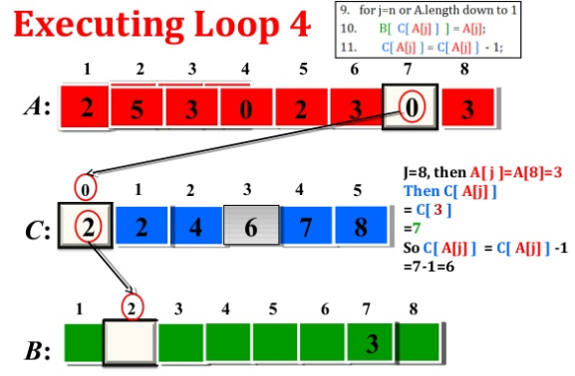
Counting Sort Example

Slide 24
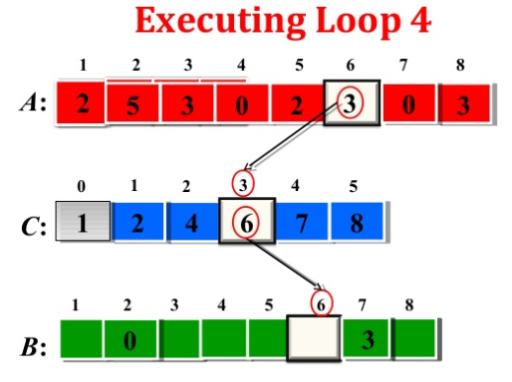
Counting Sort Example

Slide 25
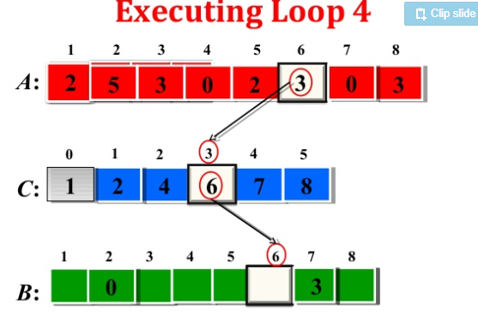
Counting Sort Example

Slide 26
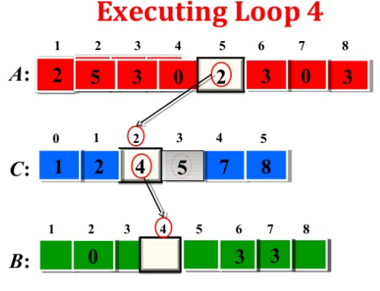
Counting Sort Example

Slide 27
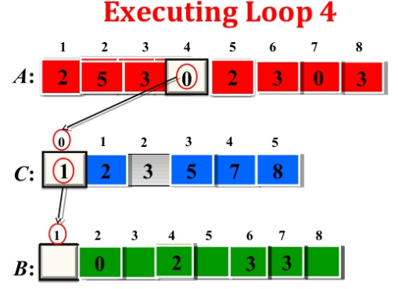
Counting Sort Example

Slide 28
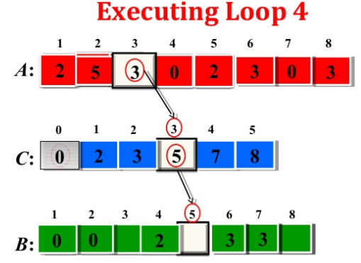
Counting Sort Example

Slide 29
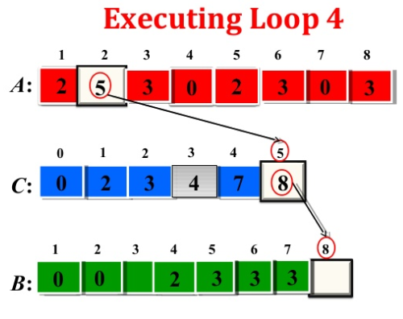
Counting Sort Example

Slide 30
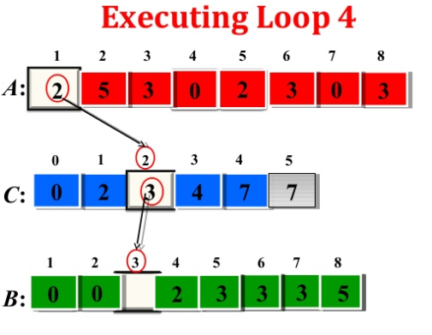
Counting Sort Example

Slide 31
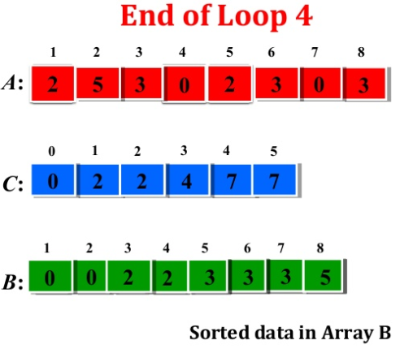
Counting Sort Example

Slide 32
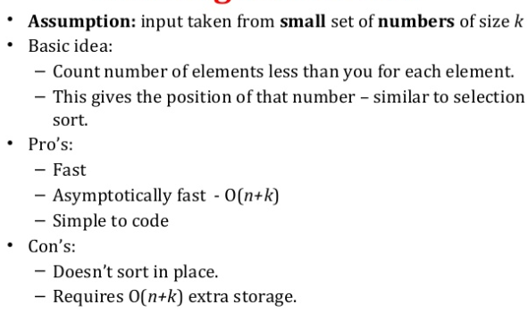
Counting Sort Summary

